Slide 1
Module 1: Getting Started with Azure Machine Learning
Notes:
Azure Machine Learning is at the core of Microsoft's cloud platform solution for machine learning. It's a platform that data scientists, machine learning specialists, software engineers, and others can use to build, deploy, and operate machine learning solutions. This module introduces the service and some of the ways in which you can work with it.

Slide 2



Agenda
Introduction to Azure Machine Learning
Working with Azure Machine Learning
Notes:
There are two lessons in this module. In the first we'll introduce Azure Machine Learning; and in the second, we'll explore different ways in which you can work with it.

Slide 3
Introduction to Azure Machine Learning
Notes:
Let's start by discovering what Azure Machine Learning is, and how to create an Azure Machine Learning workspace in an Azure subscription.

Slide 4




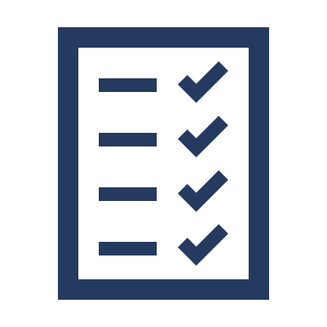

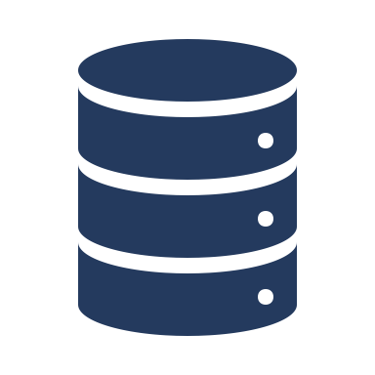

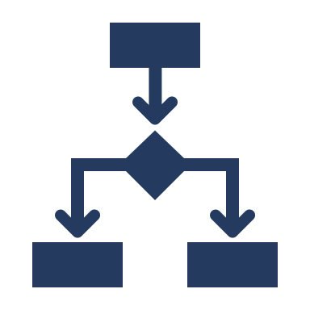



What is Azure Machine Learning?
A platform for operating machine learning workloads in the cloud
Azure Machine Learning
Scalable, on-demand compute
Data storage and connectivity
ML workflow orchestration
Model registration and management
Metrics and monitoring
Model deployment
Microsoft Azure
Notes:
Azure Machine Learning is a platform for operating machine learning workloads in the cloud.
Built on the Microsoft Azure cloud platform, Azure Machine Learning enables you to manage: - Scalable on-demand compute for machine learning workloads.
- Data storage and connectivity to ingest data from a wide range sources.
- Machine learning workflow orchestration to automate model training, deployment, and management processes.
- Model registration and management, so you can track multiple versions of models and the data on which they were trained.
- Metrics and monitoring for training experiments, datasets, and published services.
- Model deployment for real-time and batch inferencing.

Slide 5





Azure Machine Learning in Context
Data
Azure Machine Learning
ML-Powered Apps
Storage
Azure Storage
Azure Data Lake Store
Azure SQL Database
Azure Cosmos DB
Transfer and Transform
Azure Data Factory
Azure HDInsight
Azure Databricks
Application Services
Azure App Service
Azure Functions
Azure IoT Edge
Container Deployment
Azure Container Instances
Azure Kubernetes Service
Data Scientist
Run data analysis experiments using Python or R
Train models using frameworks like Scikit-Learn, PyTorch, and TensorFlow
Software Engineer / Operator
Deploy models as services
Orchestrate ML operations
Integrate ML into DevOps processes
"Citizen" Data Scientist / App Developer
Create models using graphical tools
Notes:
Now that you know a little about the capabilities Azure Machine Learning offers, it can be helpful to understand where those capabilities fit into an overall context for machine learning in Azure.
Fundamentally, machine learning is about taking data and using it to train and deliver predictive models that support ML-powered applications.
In Azure, there are many services for storing data, including Azure Storage, Azure Data Lake Store, Azure SQL Database, Azure Cosmos DB, and others. There are also services that you can use to build "big data" processing solutions that transfer and transform data, including Azure Data Factory and Apache Spark engines in Azure HDInsight and Azure Databricks.
Azure also provides services you can use to deliver applications for Web, mobile, and IoT devices; including Azure App Service, Azure Functions, and Azure IoT Edge. Azure also offers services for container-based deployment through services like Azure Container Services and Azure Kubernetes Services.
Azure Machine Learning provides a platform for operationalizing the workloads needed to drive the iterative process that enables delivery of machine learning applications built on data. There are three primary types of user that Azure Machine Learning supports in this process:
Data Scientists, who use their knowledge of statistics and data analytics to conduct analytical experiments and train machine learning models. These users typically work in Python or R, and use frameworks such as Scikit-Learn, PyTorch, and TensorFlow to train machine learning models.
"Citizen" Data Scientists and App Developers, who don’t primarily work in the field of statistical data analysis, but who need to train machine learning models to support applications. These users can take advantage of graphical tools that abstract the underlying complexity of model training.
Software engineers and operators, who need to operationalize machine learning to support applications and services. Their tasks typically involve using scripts or automated DevOps processes to manage model retraining and deployment, as well as overall application monitoring and troubleshooting.

Slide 6






Machine Learning Operationalization (ML Ops)
Based on DevOps principles, including:
Infrastructure-as-code and configuration management
Version control and tracking
Continuous integration and delivery (CI/CD)
Continuous monitoring
Experiment history, including metrics, outputs, and metadata
On-demand compute with reusable environments
Dataset and model versioning
Pipelines, event-driven automation, and CI/CD
Monitoring of deployed models and data drift
Notes:
Increasingly, enterprises are seeking to integrate machine learning model training, deployment, and management into existing processes for developing and delivering software. What's become known as "Machine Learning Operationalization", or "ML Ops" has become part of the larger move towards "Development/Operations" or "DevOps".
DevOps is a combination of best practices for team collaboration and operational automation that helps drive efficiency in creating, deploying, and managing software solutions at enterprise scale. Often, data scientists and machine learning specialists work in relative isolation from the software developers who integrate their models into applications and the system administrators who manage the deployed application infrastructure, but by adopting some DevOps principles, these disparate teams can coordinate activities to create an effective overall solution.
Azure Machine Learning provides multiple capabilities that an organization can leverage for ML Ops, and integrates with more general DevOps tools such as Azure DevOps and GitHub. The slide shows some of the key ways in which Azure Machine Learning supports ML Ops; and you'll explore these capabilities in more depth in the remainder of this course.

Slide 7







Azure Machine Learning Workspaces
Microsoft Azure
Subscription
Resource Group
Workspace
Storage Account
Application Insights
Key Vault
Container Registry
Compute
Notebooks
Pipelines
Data
Experiments
Models
Endpoints
Notes:
A workspace defines the boundary for a set of related machine learning assets. You can use workspaces to group machine learning assets based on projects, deployment environments (for example, test and production), teams, or some other organizing principle. The assets in a workspace include: - Compute targets for development, training, and deployment.
- Data for experimentation and model training.
- Notebooks containing shared code and documentation.
- Experiments, including run history with logged metrics and outputs.
- Pipelines that define orchestrated multi-step processes.
- Models that you have trained.
Workspaces are Azure resources, and as such they are defined within a resource group in an Azure subscription, along with other related Azure resources that are required to support the workspace. The Azure resources created alongside a workspace include: - A storage account - used to store files used by the workspace as well as data for experiments and model training.
- An Application Insights instance, used to monitor predictive services in the workspace.
- An Azure Key Vault instance, used to manage secrets such as authentication keys and credentials used by the workspace.
- A container registry, created as-needed to manage containers for deployed models.
The easiest way to create an Azure Machine Learning workspace is to create a Machine Learning resource in the Azure portal.
You can also create a workspace programmatically by using:
The Azure Machine Learning Python SDK
The Azure command line interface (CLI)
The Azure Machine Learning REST interface
An Azure Resource Manager template
These scriptable techniques are useful when you need to automate machine learning workspace creation as part of a self-service provisioning service or a DevOps process.

Slide 8





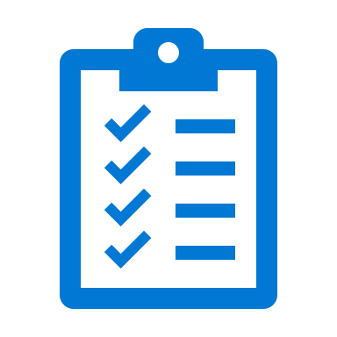





Access Control and Permissions
Default RBAC permissions
Permission | Owner | Contributor | Reader
Create workspace | ✓ | ✓
Share workspace | ✓
Create compute target | ✓ | ✓
Attach compute target | ✓ | ✓
Attach data stores | ✓ | ✓
Run experiment | ✓ | ✓
View runs/metrics | ✓ | ✓ | ✓
Register model | ✓ | ✓
Create image | ✓ | ✓
Deploy web service | ✓ | ✓
View models/images | ✓ | ✓ | ✓
Call web service | ✓ | ✓ | ✓
AAD
RBAC
User signs into Azure Active Directory (AAD) and obtains token
Token grants access to Azure Machine Learning workspace
Role-based access control (RBAC) permissions control resource access
Compute resources can optionally allow access via SSH
Deployed service endpoints can use key or token-based access
Notes:
As with any cloud resource, you need to ensure that only authorized users can access and work with assets in an Azure Machine Learning workspace.
For the most part, access to Azure Machine Learning workspace resources is managed through Azure Active Directory (AAD) role-based access control (RBAC). Typically, a user (or a service principal for an application) is authenticated by Azure Active Directory and receives an access token, this token is then used to request access to individual resources, and access is granted (or denied) based on membership of roles that have permission to perform specific actions. The default roles defined for an Azure Machine Learning workspace, and some of their most important permissions, are shown on the slide – but you can add custom roles and set custom permissions.
Some resources within an Azure Machine Learning workspace support alternative access methods. For example, compute resources (which we'll explore later) can be configured to allow access via secure shell (SSH); and when you deploy a machine learning model as a service (which again, we'll explore later), you can enable access using an AAD token or by specifying an access key.

Slide 9
Working with Azure Machine Learning
Notes:
Now that you know something about Azure Machine Learning, let's explore ways in which you can work with it.

Slide 10
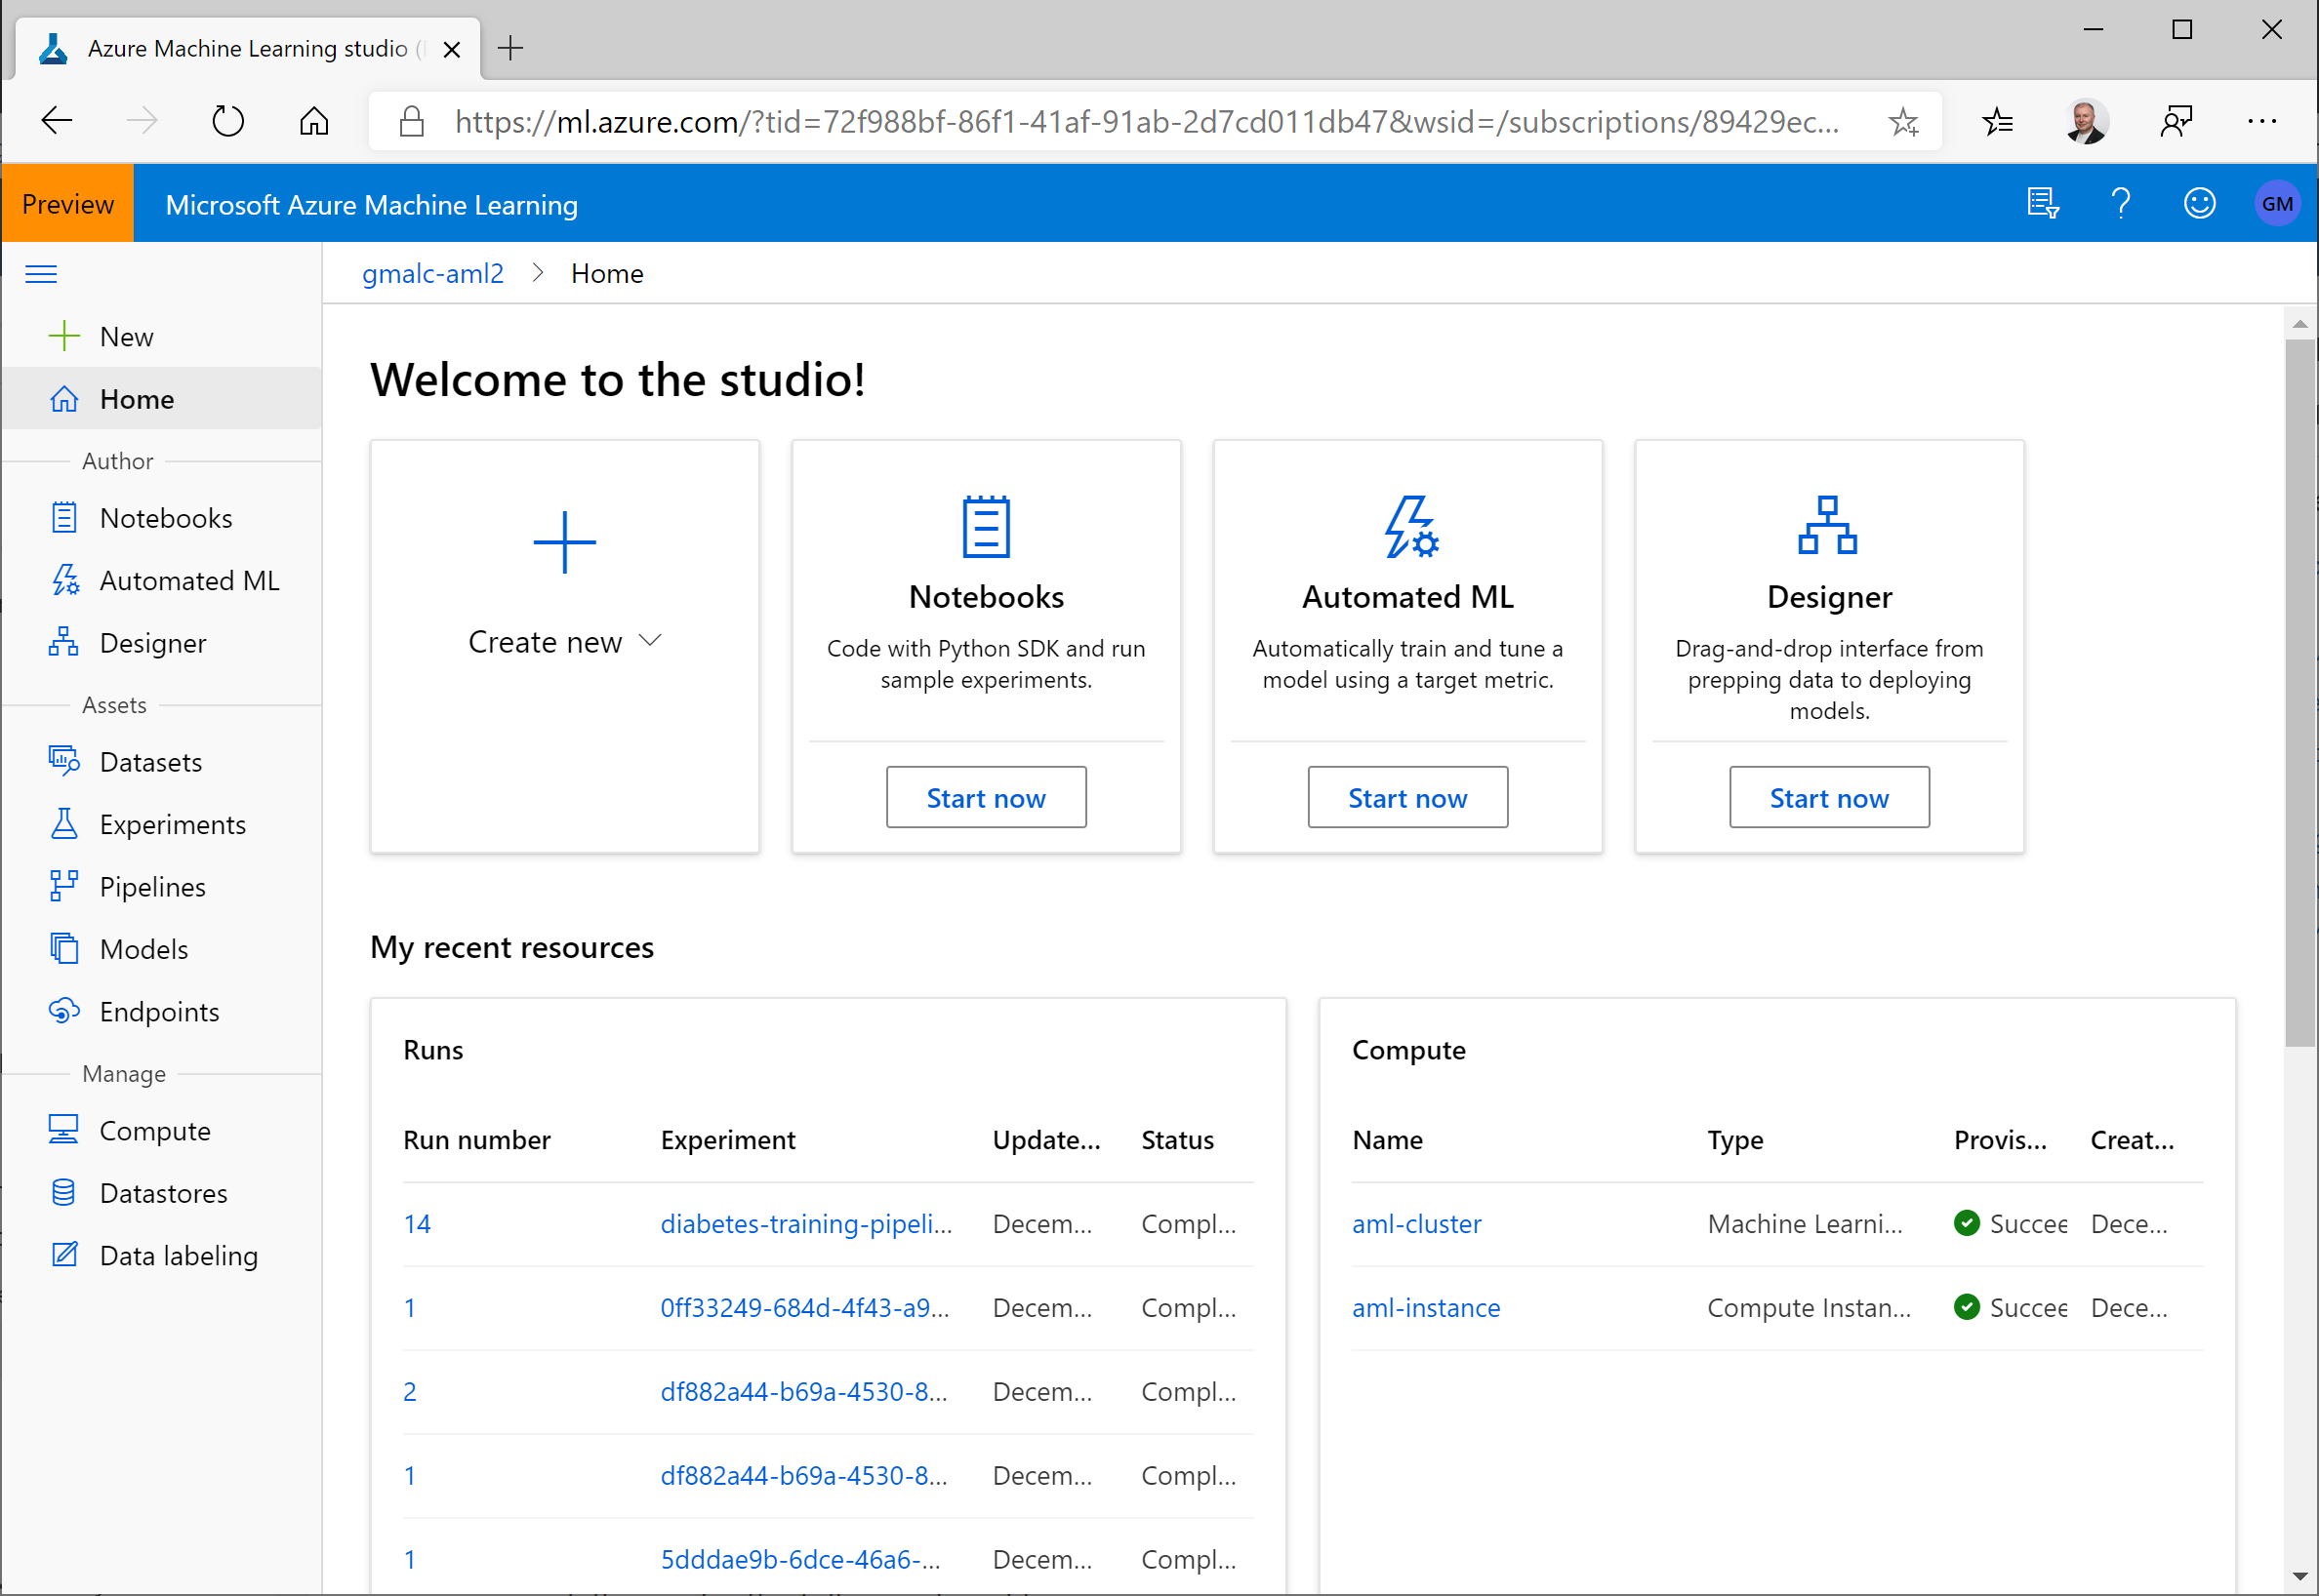
Azure Machine Learning studio
Manage compute and data
Run experiments
View metrics and logs
Manage and deploy models
Manage service endpoints
Label image data
Use graphical modeling tools:
Automated ML - find the best model for your data
Designer – drag and drop model development
Notes:
You can manage the assets in your Azure Machine Learning workspace in the Azure portal, but as this is a general interface for managing all kinds of resources in Azure, data scientists and other users involved in machine learning operations may prefer to use a more focused, dedicated interface.
Azure Machine Learning studio is a web-based tool for managing an Azure Machine Learning workspace. It enables you to create, manage, and view all of the assets in your workspace and provides the following graphical tools:
- Automated ML: A wizard interface that enables you to train a model using a combination of algorithms and data preprocessing techniques to find the best model for your data. - Designer: A drag and drop interface for "no code" machine learning model development.
Note: A previously released tool named Azure Machine Learning Studio provided a free service for drag and drop machine learning model development. The studio interface for the Azure Machine Learning service includes this capability in the *designer* tool, as well as other workspace asset management capabilities.
To use Azure Machine Learning studio, use a web browser to navigate to https://ml.azure.com and sign in using credentials associated with your Azure subscription. You can then select the subscription and workspace you want to manage.

Slide 11
The Azure Machine Learning SDK for Python
Python programming interface for Azure Machine Learning
pip install azureml-sdk
from azureml.core import Workspace
ws = Workspace.from_config()
for compute_name in ws.compute_targets:
compute = ws.compute_targets[compute_name]
print(compute.name, ":", compute.type)
Notes:
The most common way for professional data scientists and machine learning engineers to work with Azure Machine Learning is to write Python code using the Azure Machine learning Python SDK.
The SDK is installed using the Python pip utility, and consists of the main azureml-sdk package as well as numerous other ancillary packages that contain specialized functionality.
As you'll see throughout this course, most code-based interactions with Azure Machine Learning begin by retrieving a connection to a workspace. The most common way to do this is to reference a locally saved JSON file that contains the configuration information for your workspace – you can download this to your Python environment from Azure Machine Learning studio or the Azure portal. The first time you access the workspace, you'll be prompted to authenticate and get an AAD token that enables you to access the workspace. Then your code can work with the assets in the workspace to which you have access.
The documentation for the Python SDK is at https://docs.microsoft.com/python/api/overview/azure/ml.
Note: There is also an R SDK for Azure Machine Learning, but it is not a full-featured as the Python SDK; so we'll focus on Python in this course. You'll find documentation for the R SDK at https://azure.github.io/azureml-sdk-for-r/reference/index.html.

Slide 12
Azure Machine Learning CLI Extension
Cross-platform command-line interface for Azure Machine Learning
az extension add -n azure-cli-ml
az ml computetarget list -g 'my-resource-group' -w 'my-aml-workspace'
Notes:
The Azure command-line interface (CLI) is a cross-platform command-line tool for managing Azure resources. The Azure Machine Learning CLI extension is an additional package that provides commands for working with Azure Machine Learning.
To install the Azure Machine Learning CLI extension, you must first install the Azure CLI. See the full installation instructions for all supported platforms at https://docs.microsoft.com/cli/azure/install-azure-cli for more details.
After installing the Azure CLI, you can use the commands on the slide to add the Azure CLI extension and then use it to list the compute resources in a workspace. In the code sample on thew slide, the -g parameter specifies the name of the resource group in which the Azure Machine Learning workspace specified in the -w parameter is defined. These parameters are shortened aliases for --resource-group and --workspace-name.

Slide 13
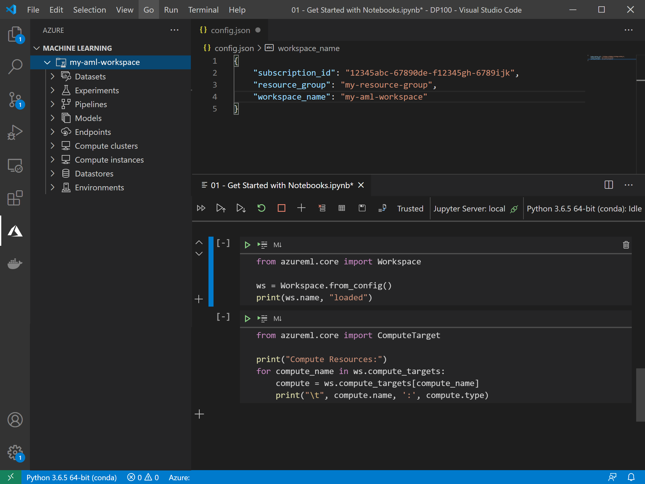
Visual Studio Code
Cross-platform code editor and integrated development environment
Tools for machine learning provided through extensions:
Python: Native Python coding and debugging, and integrated notebook interface
Azure Machine Learning: a graphical interface for working with an Azure Machine Learning workspace
Notes:
You can use your preferred code editing environment to work with Azure Machine Learning through the SDK or CLI.
Visual Studio Code is a lightweight code editing environment for Microsoft Windows, Apple macOS, and Linux. It provides a visual interface for many kinds of code, including Microsoft C#, JavaScript, Python and others; as well as intellisense and syntax formatting for common data formats such as JSON and XML.
Visual Studio Code's flexibility is based on the ability to install modular *extensions* that add syntax checking, debugging, and visual management interfaces for specific workloads. For example, the Microsoft Python extension for Visual Studio Code adds support for writing and running Python code in scripts or notebooks within the Visual Studio Code interface. In the slide, you can see the Jupyter Notebook interface (on the right at the bottom) being used to run code that uses the Azure Machine Learning SDK. Note that the config.json file in the pane above the notebook contains the information required to connect to a workspace – this was downloaded to the local development environment from Azure Machine Learning studio.
The Azure Machine Learning Extension for Visual Studio Code (the left pane on the slide) provides a graphical interface for working with assets in an Azure Machine Learning workspace. You can combine the capabilities of the Azure Machine Learning and Python extensions to manage a complete end-to-end machine learning workload in Azure Machine Learning from the Visual Studio Code environment.
For more information about using the Azure Machine Learning extension for Visual Studio Code, see the documentation at https://docs.microsoft.com/azure/machine-learning/tutorial-setup-vscode-extension.

Slide 14
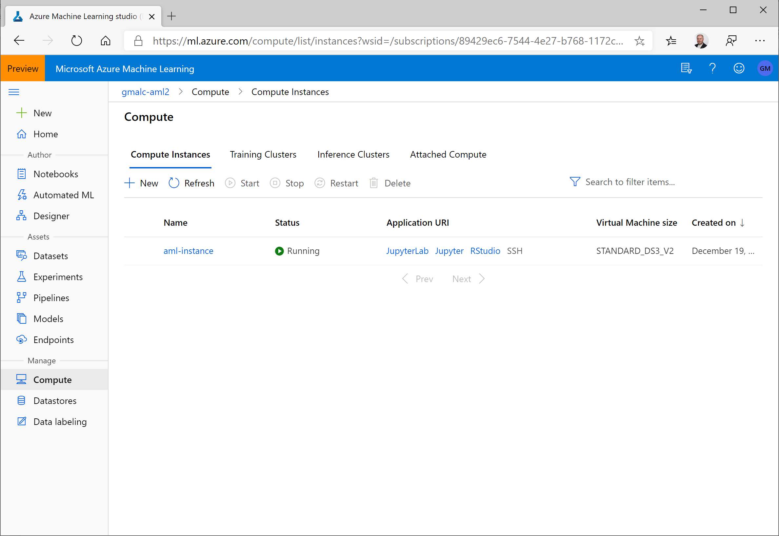
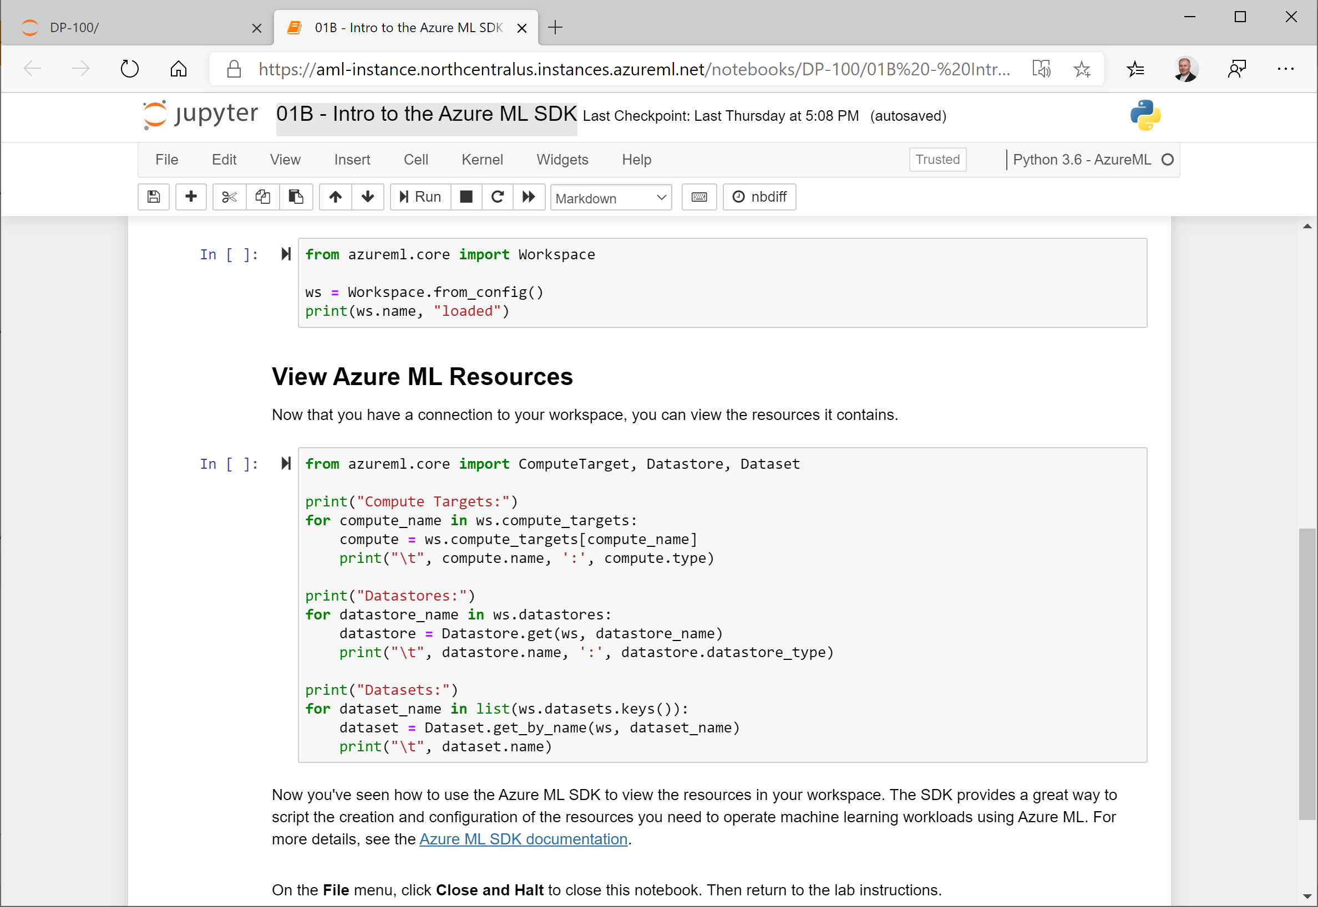
Azure Machine Learning Compute Instances
A cloud-based development workstation right in your workspace
Built-in Jupyter, JupyterLab, and RStudio
Notes:
Azure Machine Learning includes the ability to create *Compute Instances* in a workspace to provide a development environment that is managed with all of the other assets in the workspace. Compute Instances include Jupyter Notebook and JupyterLab installations that you can use to write and run code that uses the Azure Machine Learning SDK to work with assets in your workspace.
You can choose a compute instance image that provides the compute specification you need, from small CPU-only VMs to large GPU-enabled workstations. Because compute instances are hosted in Azure, you only pay for the compute resources when they are running; so you can create a compute instance to suit your needs, and stop it when your workload has completed to minimize costs. When you create a compute instance, you can also specify a virtual network, enabling you to restrict access to clients on that network rather than through a public endpoint.

Slide 15

Lab: Create an Azure Machine Learning Workspace
View the lab instructions at https://aka.ms/mslearn-dp100
Complete the Create an Azure Machine Learning workspace exercise
Notes:
Students can complete the lab using only a browser and the Azure subscription they created previously. The lab instructions are at the address on the slide.
Alternatively, if students are using a hosted environment to complete the lab, get them to start it and find ther appropriate exercise instructions..
Note that all other labs in this course depend on this one. Students must complete this lab before they can do any subsequent labs.

Slide 16

Knowledge check
Which of the following Azure resources are created alongside an Azure Machine Learning workspace?
Storage Account
Databricks workspace
Key Vault
Application Insights
Which of the following provides a web interface for managing assets in a workspace?
Azure Machine Learning studio
Azure Cognitive Services
Azure Synapse Analytics
Which Visual Studio Code extension enables integrated management of workspace assets?
Python
Azure Machine Learning
Jupyter Notebooks
Notes:
Use the slide animations to reveal the correct answers.

Slide 17
References
Microsoft Learn: Introduction to Azure Machine Learning
https://docs.microsoft.com/learn/modules/intro-to-azure-machine-learning-service
Azure Machine Learning architecture and concepts documentation
https://docs.microsoft.com/azure/machine-learning/concept-azure-machine-learning-architecture
Azure Machine Learning studio documentation
https://docs.microsoft.com/azure/machine-learning/overview-what-is-machine-learning-studio
Azure Machine Learning enterprise security documentation
https://docs.microsoft.com/azure/machine-learning/concept-enterprise-security
Azure Machine Learning Python SDK documentation
https://docs.microsoft.com/python/api/overview/azure/ml/intro
Azure Machine Learning extension for Visual Studio Code documentation
https://docs.microsoft.com/azure/machine-learning/tutorial-setup-vscode-extension
Notes:
Use the references on the slide to learn more. In particular, note the online learning modules on Microsoft Learn that are related to the material covered in this module.

Slide 18
Closing slide

